Slide 1
Section : Numerical Aptitude Topic : Number system Sub topic : Finding the factors
In this we will be seeing about
How to find total number of factors
Sum of all factors
Sum of even factors
Sum of odd factors
Product of factors

Slide 2
Finding the number of factors/divisors for a particular number
Step 1: express the given number in terms of product of prime numbers (prime factorization)
Eg: a^{x} × b^{y} ×c^{z}………
Step 2 : add 1 to all the powers and finally find the product of all.
(x+1) ×(y+1) ×(z+1) ×………….

Slide 3
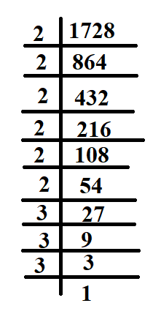
Find the total number of factors of 1728.
Prime factorization of 1728 = 2⁶ * 3³
(6+1) × (3+1) = 7×4 = 28
Find the total number of divisors of 10!
Prime factorization = 10×9×8×7×6×5×4×3×2×1 = 2⁸× 3⁴ × 5² ×7¹
(8+1) × (4+1) × (2+1) × (1+1) = 9 × 5 × 3 × 2 = 270

Slide 4
Finding the sum of factors
Step 1: express the given number in terms of product of prime numbers (prime factorization)
Eg: a^{x} × b^{y} ×c^{z}………
Step 2 : expand the powers and find the sum of each number and finally find the product of all.
(a⁰+a¹+a²+….a^{x}) ×(b⁰+b¹+…b^{y}) ×(c⁰+c¹+c²+…..c^{z})

Slide 5
Find the sum of all factors of 1728
Prime factorization of 1728 = 2⁶ * 3³
(2⁰ + 2¹ +2² ⁺ 2³ + 2⁴ + 2⁵ + 2⁶ ) * (3⁰ + 3¹ + 3² + 3³ ) = (127 * 40) = 5080
Find the sum of odd factors of 3600
Prime factorization of 3600 = 2⁴ * 3² * 5²
(3⁰ + 3¹ +3² ) * (5⁰ + 5¹ + 5² ) = (13 * 31) = 403
Find the sum of even factors of 3600
Prime factorization of 3600 = 2⁴ * 3² * 5²
2. Sum of all factors = (2⁰ + 2¹ +2² ⁺ 2³ + 2⁴ ) * (3⁰ + 3¹ +3² ) * (5⁰ + 5¹ + 5² ) = (31*13*31) = 12493
Sum of odd factors = (3⁰ + 3¹ +3² ) * (5⁰ + 5¹ + 5² ) = (13 * 31) = 403
Sum of even factors = 12493-403 = 12090 (or)
( 2¹ +2² ⁺ 2³ + 2⁴ ) * (3⁰ + 3¹ +3² ) * (5⁰ + 5¹ + 5² ) = (30*13*31) = 12090

Slide 6
Finding the product of factors of factors
Step 1: express the given number in terms of product of prime numbers (prime factorization)
Step 2 : Find the total number of factors.(n)
Step 3: Compute (Number)^{n/2}

Slide 7
Find the Product of factors of 48
Prime factorization of 48 = 2⁴ * 3
2. Total number of factors = (4+1) * (1+1)
= 5*2
= 10
3. Product of factors
= 48 ^{10/2}
= 48⁵

Slide 8
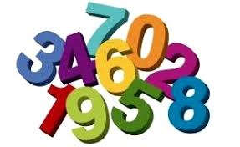
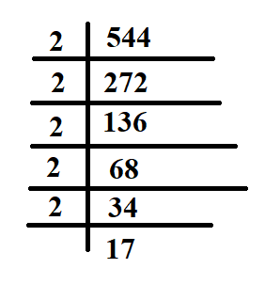
Factors/sum of factors/product of factors
Example:
Find the sum of divisors of 544 excluding 1 and 544.
Solution:
Prime Factorization: 2⁵ * 17¹
Sum of Factors = (2⁰ + 2¹ +2² ⁺ 2³ + 2⁴ + 2⁵ ) * (17⁰ + 17¹)
= (1+2+4+8+16+32)*(1+17)
= (63)*(18)
= 1134
Since we need to exclude 1 and 544 we need to subtract (1+544)
= 1134-545
= 589

Slide 9
Factors/sum of factors/product of factors
Example:
Find the sum of divisors of 544 which are perfect squares.
Solution:
Prime Factorization: 2⁵ * 17¹
Sum of Factors = (2⁰ + 2¹ +2² ⁺ 2³ + 2⁴ + 2⁵ ) * (17⁰ + 17¹)
Since we need sum of factors which are perfect squares we consider,
= (2⁰ + 2² + 2⁴ ) * (17⁰)
= 21

Slide 10
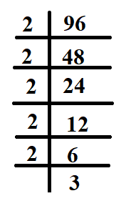
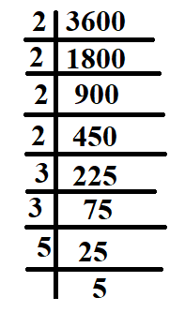
Factors/sum of factors/product of factors
Example:
Find the sum of the sum of even divisors of 96 and the sum of odd divisors of 3600.
Solution:
Prime Factorization of 96 = 2⁵ * 3¹
Prime Factorization of 3600 = 2⁴ * 3² * 5²
Sum of even Factors of 96
= ( 2¹ +2² ⁺ 2³ + 2⁴ + 2⁵ ) * (3⁰ + 3¹)
= (62)*(4)
= 248
Sum of odd Factors of 3600
(3⁰ + 3¹ + 3² ) * (5⁰ + 5¹ + 5²) = 13* 31
= 403
Answer = 248+403
= 651

Slide 11
Section : Numerical Aptitude Topic : Number system Sub topic : Divisibility Rules.
Divisibility Rules for various Numbers with examples
Remainder problems based on the divisibility rules
Commonly asked problems under this particular topic in Placements & other Competitive examinations.

Slide 12
Divisibility Rules
A number is divisible by 2^{n} if the last n digits are divisible by 2^{n}
Divisible by 2: If the last digit is divisible by 2. 12, 142, 68…
Divisible by 4: If the last 2 digits are divisible by 4. 724, Last 2 digits (24) gives a number divisible by 4.
Divisible by 8: If the last 3 digits are divisible by 8. 1040, Last 3 digits (040) gives a number divisible by 8.
Divisible by 16:If the last 4 digits are divisible by 16. 8891440, Last 4 digits (1440) gives a number divisible by 16.
Like this we can extend for numbers such as 64,128,256…….so on.

Slide 13
Divisibility Rules
A number is divisible by 5^{n} if the last n digits are divisible by 5^{n}
Divisible by 5: If the last digit is 5 or 0. E.g. 625, 310 etc…
Divisible by 25: If the last two digits are divisible by 25 Eg: 125, 50 etc..
Divisible by 125: If the last three digits are divisible by 125 Eg: 1250, 3500 etc..

Slide 14
Divisibility Rules
In a number if the sum of digits is divisible by n then the given number will be definitely divisible by n, where n=3 or 9
Divisible by 3: Sum of digits of the number is divisible by 3. 15672, sum of digits = 1+5+6+7+2 = 21 = 3 * 7, hence divisible by 3.
Divisible by 9: If the sum of the digits is divisible by 9 972036, sum of the digits = 9 + 7 + 2 + 0 + 3 + 6 = 27, divisible by 9.
The sum of the digits will be remainder when the particular number is divided by 9.
75622 when divided by 9 the remainder will be =7+5+6+2+2 = 22 = 2+2 = 4

Slide 15
Divisibility Rules
Divisible by 10^{n} + 1 : Mark off the number in groups of n digits starting from the right, and add the n-digit groups together with alternating signs. If the sum is divisible by 10^{n} + 1 then the original number is also divisible by 10^{n} + 1.
Divisible by 11: If the difference between the sum of digits at the odd place and the sum of digits at the even place is zero or divisible by 11. 1639, (9+6) - (3+1) = 11, divisible by 11
Divisible by 101: Mark off the number in groups of two digits starting from the right, and add the two-digit groups together with alternating signs. If the sum is divisible by 101 then the original number is also divisible by 101. Eg: 4512276, (76 + 51) - (22 + 4) = 101, hence divisible by 101.
Divisible by 1001: Mark off the number in groups of three digits starting from the right, and add the three-digit groups together with alternating signs. If the sum is divisible by 1001 then the original number is also divisible by 1001. Eg: 9533524, (524 + 9 ) - 533 = 0, hence divisible by 1001.

Slide 16
Divisibility Rules
Co-prime numbers:
Two or more numbers that do not have a common factor are known as co-prime or relatively prime. For example: 4 and 15 are Co-prime numbers.
Divisible by 6: If the number is divisible by both 3&2 then the number will be divisible by 6. Divisible by 12: If the number is divisible by both 3&4 then the number will be divisible by 12.
Divisible by 15: If the number is divisible by both 3&5 then the number will be divisible by 15.
Divisible by 18: If the number is divisible by both 2&9 then the number will be divisible by 18.
Divisible by 24: If the number is divisible by both 3&8 then the number will be divisible by 24.
Divisible by 36: If the number is divisible by both 4&9 then the number will be divisible by 36.
Divisible by 33: If the number is divisible by both 3&11 then the number will be divisible by 33.
Divisible by 99: If the number is divisible by both 9&11 then the number will be divisible by 99.
Divisible by 72: If the number is divisible by both 9&8 then the number will be divisible by 72………

Slide 17
Divisibility Rules
Any digit repeated ( P - 1 ) times is divisible by P, where P is a prime > 5
Example:
55555555555555 – here 5 is repeated 12 times we can definitely say this number will be divisible by 13.
7777777777777777 – here 7 is repeated 16 times we can definitely say this number will be divisible by 17.

Slide 18
Divisibility Rules
Divisibility Rule for 7,13, 17
Divisibility Rule for 7: Subtract 2 times the last digit from remaining truncated number. Repeat the step as necessary. If the result is divisible by 7, the original number is also divisible by 7
Check for 945: : 94-(2*5)=84. Since 84 is divisible by 7, the original no. 945 is also divisible
Divisibility Rule for 13: Add 4 times the last digit to the remaining truncated number. Repeat the step as necessary. If the result is divisible by 13, the original number is also divisible by 13
Check for 3146:: 314+ (4*6) = 338:: 33+(4*8) = 65. Since 65 is divisible by 13, the original no. 3146 is also divisible
Divisibility Rule for 17: Subtract 5 times the last digit from remaining truncated number. Repeat the step as necessary. If the result is divisible by 17, the original number is also divisible by 17
Check for 2278:: 227-(5*8)=187. Since 187 is divisible by 17, the original number 2278 is also divisible.

Slide 19
Divisibility Rules
Example:
A hundred and twenty digit number is formed by writing the first x natural numbers in front of each other as 12345678910111213.... Find the remainder when this number is divided by 8.
Solution:
We know the divisibility rule for 8 , just take last 3 digits and divide by 8
Here first we need to find the last three digits of a 120 digit number.
Single digit numbers 1-9 will fill first 9 digits, remaining 120-9 = 111 digits will be filled with two digit numbers. 110 digits can be filling by accommodating 55 two digit numbers after 9 so it will go till 64 and the next digit will be 6 ,which means the formation will be like
1234567891011………………………………………..63646.
646 when divided by 8 the remainder will be 6.

Slide 20
Divisibility Rules
Example:
When the number 12345678910111213………….40 is divided by 9 what will be the remainder?
Solution:
We know to find the remainder when a number is divided by 9 just we need to find the sum of the digits.
1+2+3+4+5+6+7+8+9+(1+0)+(1+1)+…………..+(1+8)+(1+9)+……+(2+7)+(2+8)+…..+(3+6)
9*10/2 = 45 9*10/2 = 45 9*10/2 = 45 45
3+7+3+8+3+9+4+0 = 10+11+12+4 = 37 = 1
Therefore , Remainder = 1.
Solution:
We know to find the remainder when a number is divided by 9 just we need to find the sum of the digits.
1+2+3+4+5+6+7+8+9+(1+0)+(1+1)+…………..+(1+8)+(1+9)+……+(2+7)+(2+8)+…..+(3+6)
9*10/2 = 45 9*10/2 = 45 9*10/2 = 45 45
3+7+3+8+3+9+4+0 = 10+11+12+4 = 37 = 1
Therefore , Remainder = 1.

Slide 21
Divisibility Rules
Example:
The six digit number 7A386B is divisible by 36 . What can be the possible value of A*B
Solution:
If a number has to be divisible by 36 then it has to be divisible by both 4 & 9
First we consider the divisibility Rule for 4 . So based on that last two digits has to be divisible by 4 so B value can be either 4 or 8. 64,68 is divisible by 4
Now we need to find A based on fixing B
7+A+3+8+6+ 4 = 28+A should be divisible by 9 so A value must be 8.
7+A+3+8+6+8 = 32+A should be divisible by 9 so A value should be 4.
If A=8 , then B =4 or If A=4 then B = 8 . In both cases A*B = 32.

Slide 22
Divisibility Rules
Example:
The seven digit number 27A46B5 is divisible by 99 . What can be the possible value of A&B
Solution:
If a number has to be divisible by 99 then it has to be divisible by both 11 & 9.
Divisibility Rule for 9 : Sum of digits should be divisible by 9
2+7+A+4+6+B+5 = 24+A+B Now 24+A+B has to be divisible by 9 we know 36 is a multiple of 9 so
A+B has to be 12. If we consider 45 then A+B has to be 21 which is not possible with two single digit number.
Divisibility Rule for 11: Sum of digits in odd positions ~ Sum of digits in even positions should be 0 or multiple of 11.
(2+A+6+5)~(7+4+B) = 0 or 11
(13+A)~(11+B) = 0 or 11
Since A+B has to be 12 possible combinations are (3,9), (4,8),(5,7). Only (5,7) will satisfy the criteria so value of A&B will be 5&7.

Slide 23
Divisibility Rules
Example:
Let b be a positive integer and a = b² - b. If b ≥ 4 then a² - 2a is divisible by:
a. 15 b. 20 c. 24 d. all of these
Solution:
Substitute the value of a in terms of b
a² - 2a = (b² – b)² – 2(b² – b)
= b⁴ - 2 b³ + b² -2 b² +2 b
= b⁴ - 2 b³ - b² +2 b = b⁴ - b² - 2 b³ +2 b = b² (b² - 1 ) -2b (b² - 1)
= (b² - 2b)(b² - 1) = b(b-2) (b+1) (b-1) = (b-2)(b-1)(b)(b+1)
Since b ≥ 4 sub b=4 → (2*3*4*5) -→ it is divisible by all of these
b=5 → (3*4*5*6) , b=6 →(4*5*6*7) , b=7 → (5*6*7*8) which is divisible by all the three
But when b=8
(6*7*8*9) it is not divisible by 15 & 20 but divisible by 24. So the answer should be only 24.

Slide 24
Divisibility Rules
Example:
The digits of a three-digit number A are written in the reverse order to form another three-digit number B. If B > A and B-A is perfectly divisible by 7, then which of the following is necessarily true?
A. 100 < A < 299 B. 106 < A < 305 C. 112 < A < 311 D. 118 < A < 317
Solution:
Let the three digit number be xyz which is A = 100 x + 10 y + z
When the three digit number is reversed B = 100 z + 10 y + x
B – A = 99z – 99x = 99 (z-x)
since 99 is not divisible by 7 (Z-X) has to be divisible by 7
so the possible value of Z and X will be = 8-1 =7 or 9-2 = 7
So minimum value is 108 and maximum value 299
Now check the options which has both the values in the set
It matches with only option B. So that’s our answer.

Slide 25
Section : Numerical Aptitude Topic : Number system Sub topic : HCF & LCM
Factor:
A factor divides a number completely without leaving any remainder.
Example: 30 ÷ 6 = 5, and there is no remainder. So we can say that 1, 2, 3, 5, 6, 10 , 15 and 30 are the factors of 30.
Multiples:
The multiples of a number are the values obtained by multiplying the number with the other.
For examples the multiples of 5 are 5,10,15,20,25,30,………….100,105,…..355… etc
Common multiples: Common multiples of two or more numbers are the numbers which can be exactly divided by each of the given number.
For example, Multiples of 3 are 3,6,9,12,15,18,21,24 etc. and Multiples of 4 are 4,8,12,16,20,24,28 etc.
Common multiples of 3 and 4 are 12,24 etc.

Slide 26
HCF & LCM
HCF (Highest Common Factor) or GCF (Greatest Common Factor):
HCF or Highest Common Factor of two or more numbers is the greatest factor which divides the numbers. For example, 2 is the HCF of 4 and 6.
HCF of fraction numbers = $\frac{HCF of Numerator}{LCM of Denominator}$
Example: HCF of $\frac{3}{4},\frac{2}{3} ,\frac{6}{8}$ = $\frac{1}{24}$
LCM ( Least Common Multiple):
LCM or Least common multiple is the smallest number which is divisible by two or more given numbers. For example, LCM of 2 & 3 is 6.

Slide 27
HCF & LCM
LCM of fraction numbers = $\frac{LCM of Numerator}{HCF of Denominator}$
Example: LCM of $\frac{3}{4},\frac{5}{16} ,\frac{7}{8}$ = $\frac{105}{4}$
Relation between HCF & LCM of two numbers:
Let us consider two numbers ‘a’ & ‘b’
Then,
HCF of (a,b) × LCM of (a,b) = Product of a and b

Slide 28
HCF & LCM
Methods to find HCF & LCM:
Prime Factorization
Division method
Prime Factorization for HCF
Take an example of finding the highest common factor of 144, 104 and 160. Now let us write the prime factors of 144, 104 and 160. 144 = 2 × 2 × 2 × 2 × 3 × 3 104 = 2 × 2 × 2 × 13 160 = 2 × 2 × 2 × 2 × 2 × 5 The common factors of 144, 104 and 160 are 2 × 2 × 2 = 8 Therefore, HCF (144, 104, 160) = 8

Slide 29
HCF & LCM
Division method 1: (explanation based on example)
Find highest common factor (H.C.F) of 184, 230 and 276
2 184, 230 , 276
23 92, 115, 138
4, 5, 6
HCF = 2*23 = 46
Division method 2 : (explanation based on example)
Find highest common factor (H.C.F) of 184, 230 and 276
Take any two number and find the hcf of it by following certain steps
184 230 1
184
46 184 4
184
0

Slide 30
HCF & LCM
Now divide the third number with the hcf of the other two
46 276 4
276
0
It is completely divisible so we can say that the HCF of 184, 230 and 276 is 46.
Co-prime numbers:
Two or more numbers that do not have a common factor are known as co-prime or relatively prime.
For example: 4 and 15 are Co-prime numbers.

Slide 31
HCF & LCM
LCM: The concept of LCM will be used as shortcut to solve problems in various topics such as time, speed , distance & Time & Work, etc.
Division method 1: (explanation based on example)
Find least common multiple (L.C.M) of 420,460,112,108
2 420, 460, 112, 108
2 210, 230, 56, 54
5 105, 115, 28, 27
7 21 , 23, 28, 27
3 3, 23, 4, 27
1, 23, 4, 9
LCM = 2*2*5*7*3*23*4*9 = 30240

Slide 32
HCF & LCM
Type 1:
The greatest number that will exactly divide x,y, z= H.C.F of x, y and z.
Example:
Find the largest number that divides 735,819, 714
Solution:
HCF (735,819,714)
3 735, 819, 714
7 245, 273, 238
35 , 39 , 34
HCF = 3*7 = 21 , So 21 will be the greatest number that divides 735,819 and 714

Slide 33
HCF & LCM
Type 2:
The greatest number that will divide x, y and z leaving remainders a, b and c respectively =H.C.F of (x- a), (y -b) and (z – c).
Example:
Find the greatest number, which on dividing 1448, 1355 and 2020 leaves remainders 8, 11 and 4 respectively.
Solution: We need to find the HCF of (1448-8,1355-11,2020-4) , HCF of (1440,1344,2016)
2 1440, 1344 , 2016
2 720, 672 , 1008
2 360, 336 , 504
2 180, 168 , 252
2 90 , 84 , 126
45 , 42 , 63
HCF = 2*2*2*2*2 = 32

Slide 34
HCF & LCM
Type 3:
The least number which is exactly divisible by x, y and z. = L.C.M of x, y and z.
Example:
Find the largest number of 4-digits divisible by 12, 15 and 18.
Solution: We need to find the LCM of 12, 15 , 18
3 12 , 15 , 18
2 4 , 5 , 6 LCM = 3*2*2*5*3 = 180
2 , 5 , 3
Largest 4 digit number is 9999 so to find the largest four digit number which is a multiple of 180 is
55
180 9999 in order to find the multiple of 180
900 we need to subtract 99 from the dividend
999 so 9999-99 = 9900
900
99

Slide 35
HCF & LCM
Type 4:
The least number which when divided by x, y and z leaves the remainder a, b and c respectively= L.C.M of(x, y and z) – R where R=(x – a)=(y – b) = (z – c)
Example:
Find the greatest number of six digits which on being divided by 6, 7, 8, 9 and 10 leaves 4, 5, 6, 7 and 8 as remainders respectively.
Solution: LCM of (6,7,8,9,10) = 2520
The greatest number of 6 digits = 999999
Dividing 999999 by 2520, we get 2079 as remainder. Hence the 6 digit number divisible by 2520 is 999999 -2079 = 997920
Since 6 – 4=2, 7 – 5 = 2, 8 – 6 = 2, 9 – 7 = 2,
10 – 8 = 2, the remainder in each case is less than the divisor by 2.
∴Required number = 997920 – 2 = 997918

Slide 36
HCF & LCM
Type 5:
The least number which when divided by x, y and z leaves the same remainder r in each case = L.C.M of (x, y and z)+r
Example:
What least number must be subtracted from 1936 so that the remainder when divided by 9, 10,15 will leave in each case the same remainder 7?
Solution:
The L.C.M. of 9,10 and 15 is 90.
On dividing 1936 by 90, the remainder =46
But 7 is also a part of this remainder.
∴Required number = 46 – 7 = 39.

Slide 37
HCF & LCM
Type 6:
The greatest number that will divide x, y and z leaving the same remainder in each case = H.C.F of (x – y), (y – z) and (z- x).
Example:
What is the greatest number that will divide 82, 111 and 140 leaving the same remainder in each case ?
Solution:
Using the formula, the greatest number which divides three numbers x, y and z,
leaving the same remainder in each case is HCF(x-y, y-z, z-x)
111-82 = 29
140-82 = 58
140-111 = 29
HCF(29,58,29) = 29

Slide 38
HCF & LCM
Type 7:
When two numbers are considered and one number is a factor of another number then just divide the remainder alone to get the expected value.
Example:
When a number is divided by 84 the remainder is 56 when the same number is divided by 21 what is the remainder?
Solution:
Here we have two number 84 and 21 as divisors though we don’t know the dividend we know 21 is a factor of 84 so if a number is divisible by 84 then the number will definitely divisible by 21 as well so its enough to consider only the remainder.
56 when divided by 21 the remainder is 14 .
Divisor Remainder
84 56
21 14

Slide 39
HCF & LCM
Points to remember
The greatest number that will exactly divide x,y, z= H.C.F of x, y and z.
The greatest number that will divide x, y and z leaving remainders a, b and c respectively =H.C.F of (x- a), (y -b) and (z – c).
The least number which is exactly divisible by x, y and z. = L.C.M of x, y and z.
The least number which when divided by x, y and z leaves the remainder a, b and c respectively= L.C.M of(x, y and z) – R where R=(x – a)=(y – b) = (z – c)
The least number which when divided by x, y and z leaves the same remainder r in each case = L.C.M of (x, y and z)+r
The greatest number that will divide x, y and z leaving the same remainder in each case = H.C.F of (x – y), (y – z) and (z- x).
When two numbers are considered and one number is a factor of another number then just divide the remainder alone to get the expected value.

Slide 40
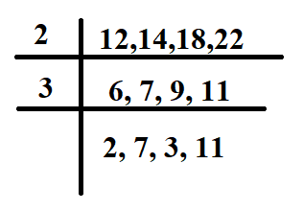
HCF & LCM
What is the least number which when doubled will exactly be divisible by 12, 14, 18 and 22?
A. 2772 B. 1216 C. 1286 D. 1386
Solution:
Since the number has to be divisible by 12,14,18 and 22
LCM (12,14,18,22)
LCM = 2*3*2*7*3*11
= 2772
But the number when doubled should be exactly divisible by
(12,14,18,22)
So the number is 2772/2 = 1386
Option: D

Slide 41
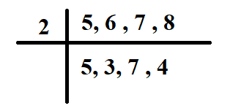
HCF & LCM
What is the least number which when divided by 5, 6, 7 and 8 leaves a remainder 3, but when divided by 9 leaves no remainder?
A. 1108 B. 1683 C. 2007 D. 3363
Solution:
The number leaves the same remainder in each case so we need to find the LCM of 5,6,7 and 8 and add the remainder to it.
LCM of 5,6,7,8 = 2*5*3*7*4
= 840
Since it leaves same remainder add that to the LCM
= 840 + 3 = 843 (it is not divisible by 9)
So we need to consider next common multiple
= 840*2 + 3 = 1680+3
= 1683 (it is divisible by 9)
Answer = option (c)

Slide 42
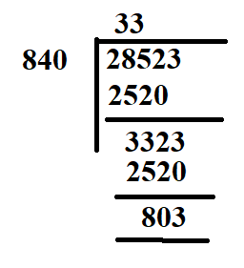
HCF & LCM
The least number which should be added to 28523 so that the sum is exactly divisible by 3, 5, 7 and 8 is:
A. 41 B. 42 C. 32 D. 37
Solution:
The number has to be exactly divisible by 3,5,7 and 8
So L.C.M(3,5,7,8) = 3*5*7*8 = 840
To find the number to be added to 28523 we need to divide
The number by 840
Remainder = 803
To make it a multiple of 840 we need 37 more. (840-803)
So the answer is option: D

Slide 43
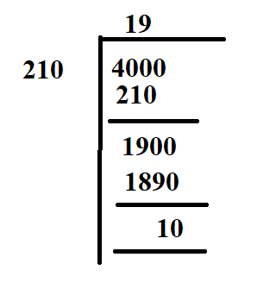
HCF & LCM
A number is such that when divided by 3, 5, 6, or 7 it leaves the remainder 1, 3, 4, or 5 respectively. Which is the largest number below 4000 that satisfies this property?
A. 3358 B. 3988 C. 3778 D. 2938
Solution:
In this question The difference between the divisors and the corresponding remainders are same.
When divided by 3 remainder 1, when divided by 5 remainder 3……..
Common difference = 2
So We need to find the LCM or common multiple and subtract the common difference
LCM(3,5,6,7) = 3*1*5*2*7 = 210
In order to find the larger number less than 4000, We need to find the
Common multiple of 210 which is less than 4000.
Since Remainder is 10 we need to subtract 10 from dividend = 4000-10 = 3990
We know common difference is 2 so we need to subtract 2 from the common multiple
= 3990-2 = 3988 (B)

Slide 44
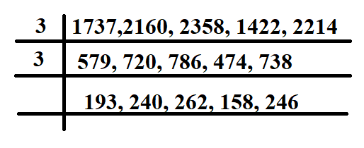
HCF & LCM
The sides of a pentagonal field (not regular) are 1737 meters, 2160 metres, 2358 metres, 1422 metres and 2214 metres respectively. Find the greatest length of the tape by which the five sides may be measured
completely.
A. 7 B. 13 C. 11 D. 9
Solution:
In order to find the greatest length we need to find the H.C.F
H.C.F (1737, 2160, 2358, 1422, 2214 ) = 9
So the answer is 9

Slide 45
HCF & LCM
Find the length of the plank which can be used to measure exactly the lengths 4 m 50 cm, 9 m 90 cm and 16 m 20 cm in the least time.
Solution:
The length of the plank that exactly divides all the three lengths. Which means we need to find the HCF.
HCF of 450,990,1620
10 450,990,1620
9 45 , 99, 162
5, 11 , 18
HCF = 10 * 9 =90 cm
we need a plank of length 90 cm to measure the given lengths in the least time.

Slide 46
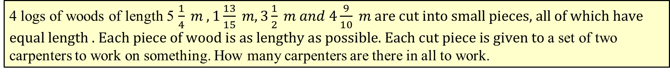
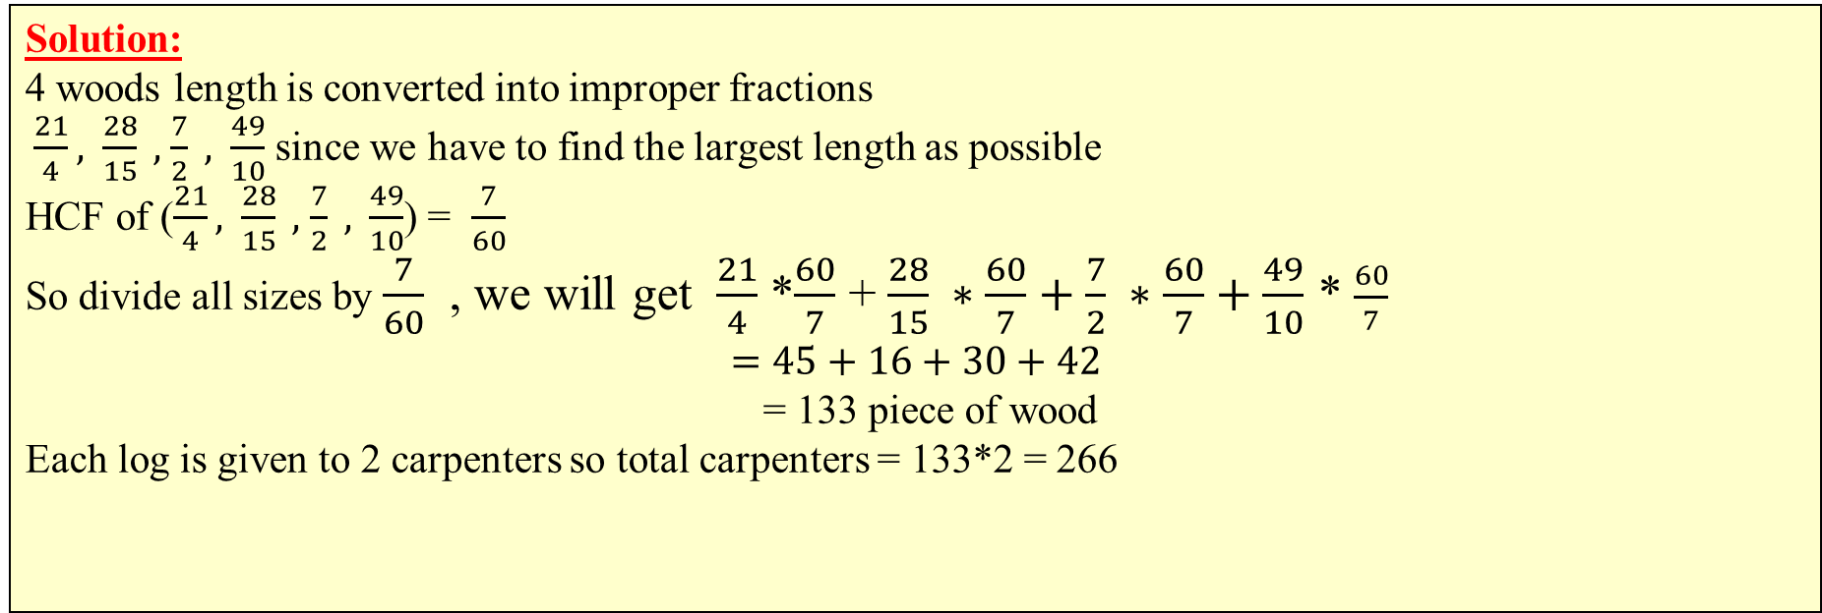
HCF & LCM
4 logs of woods of length 5 $\frac{1}{4} m , 1\frac{13}{15} m, 3\frac{1}{2} m and 4\frac{9}{10} m \text{are} \text{cut} \text{into} \text{small} \text{pieces}\text{, }\text{all} \text{of} \text{which} \text{have} \text{equal} \text{length}\text{ . }\text{Each} \text{piece} \text{of} \text{wood} \text{is} \text{as} \text{lengthy} \text{as} \text{possible}\text{. }\text{Each} \text{cut} \text{piece} \text{is} \text{given} \text{to}$ a set of two carpenters to work on something. How many carpenters are there in all to work.
Solution:
4 woods length is converted into improper fractions
$\frac{21}{4},$ $\frac{28}{15} ,$ $\frac{7}{2} ,$ $\frac{49}{10}$ since we have to find the largest length as possible
HCF of ($\frac{21}{4},$ $\frac{28}{15} ,$ $\frac{7}{2} ,$ $\frac{49}{10}$) = $\frac{7}{60}$
So divide all sizes by $\frac{7}{60}$ , we will get $\frac{21}{4}$ *$\frac{60}{7}$ + $\frac{28}{15} ∗\frac{60}{7}+\frac{7}{2} ∗\frac{60}{7}+\frac{49}{10}$ * $\frac{60}{7}$
$$=45+16+30+42$$
= 133 piece of wood
Each log is given to 2 carpenters so total carpenters = 133*2 = 266

Slide 47

Thank you

